Slide 1
PIP2001 Capstone Project
Review-1
PROJECT TITLE :- PSCS235 A one Stop Solution focusing on Tourism
Batch Number: CIT-G06
Student Name | Roll Number
Puneeth N | 20221LIN0004
Rohan Gowda A | 20221LIN0003
Ajin V Joseph | 20221LIN0007
Under the Supervision of,
Dr Shanthi S
Associate Professor
School of Computer Science and Engineering
Presidency University
Name of the Program: Btech CSE(IoT)
Name of the HoD: Dr. Anandaraj S P
Name of the Program Project Coordinator: Dr. Sharmasth Vali Y
Name of the School Project Coordinators: Dr. Sampath A K / Dr. Abdul Khadar A / Mr. Md Ziaur Rahman

Slide 2
Introduction
This project delivers a travel website that inspires wanderlust through vibrant imagery and key destination highlights. It offers budget-friendly bookings, easy payments, and full customer support, along with immersive virtual tours via videos and images, The One-Stop Solution for Tourism is more than just a travel tool; it’s a gateway to discovering the world with ease, saving time, reducing stress, and providing meaningful experiences. Whether users are seasoned travelers or planning their first vacation, the platform makes it easier to explore the world, enhancing every step of the journey with technology, convenience, and personalization.
At its core, the platform focuses on providing a seamless user experience. It integrates services like secure payments, real-time customer support, and travel insurance options, ensuring that users feel supported from the moment they begin planning their trip until they return home. With the growing focus on eco-friendly travel, the project also promotes sustainable tourism by offering environmentally responsible options for accommodations and activities.

Slide 3
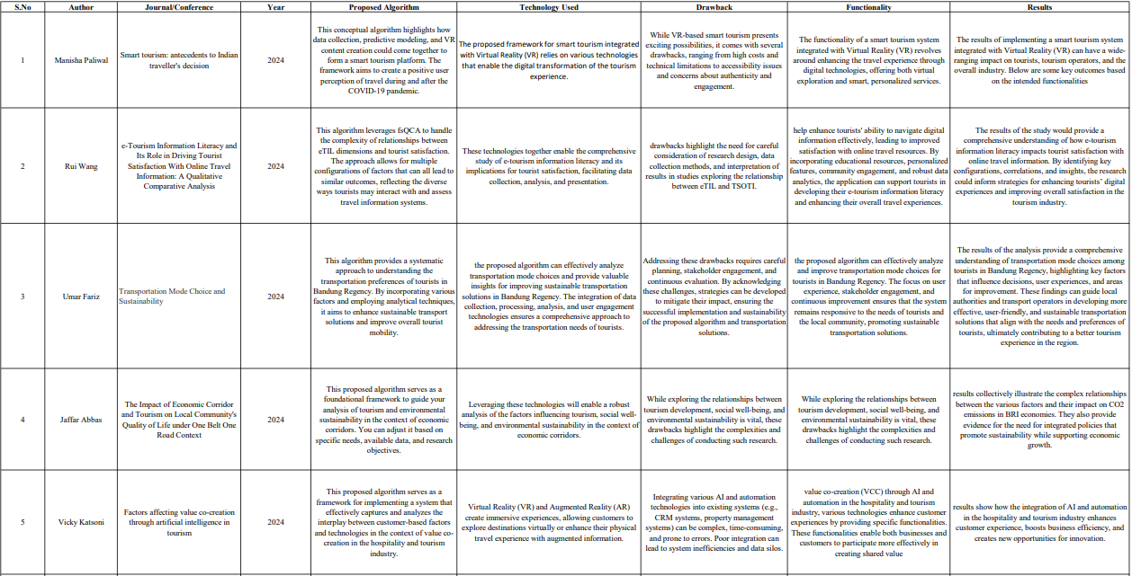
Literature Review

Slide 4
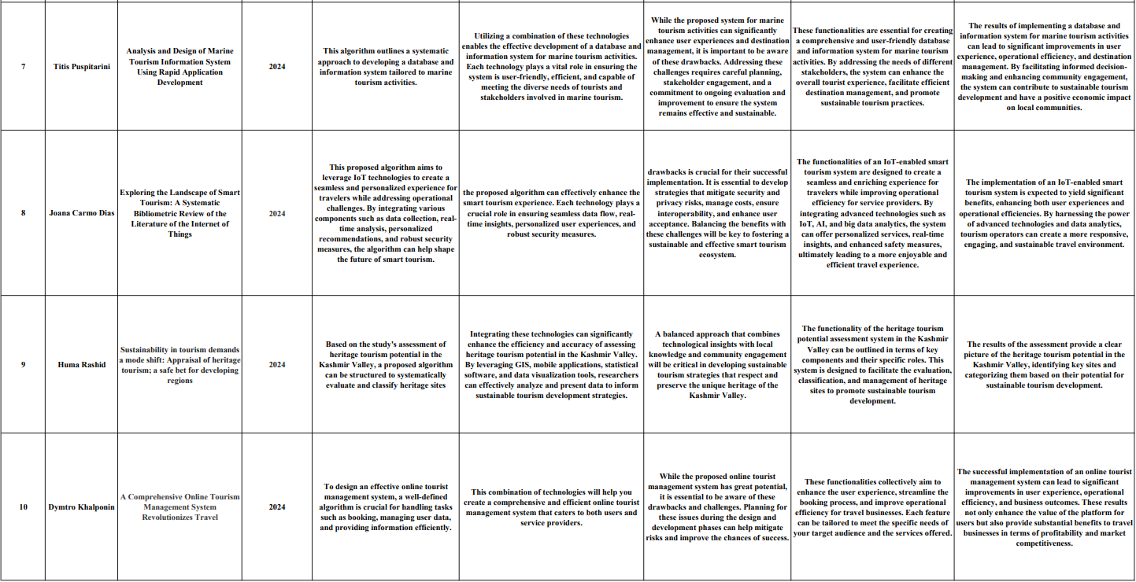
Literature Review

Slide 5
Proposed Method
Language Assistance Tools
Trip Budget Planner
Destination Safety rating
Seasonal Travel Guides
Real-time Travel Updates
Virtual Reality Previews

Slide 6
Objectives
Assess Tourist Satisfaction and Preferences
Analyze Economic Impact
Identify Trends and Future Projections
Evaluate Sustainability and Environmental Impact
Understand Cultural and Social Impact
Provide Stakeholder Insights and Recommendations
Support Policy and Strategic Planning

Slide 7
Methodology
Problem Identification
Continuous Improvement
Planning and Design
Monitoring and Evaluation
Implementation

Slide 8
Software and Hardware Components
1)Software Requirements:
Frontend:
- HTML5, CSS3, JavaScript (React.js or Angular for dynamic content)
- Responsive design (Bootstrap or Tailwind CSS)
- Integration with third-party APIs for services like Google Maps, Booking.com, etc.
Backend:
- Node.js with Express.js or Django (Python) for the server-side framework
- RESTful APIs for communication between frontend and backend
- Payment Gateway Integration (Stripe, PayPal)
Database:
- PostgreSQL or MySQL for relational data (user profiles, bookings)
- MongoDB for flexible storage (itineraries, reviews)
Cloud Services and Hosting:
- AWS, Google Cloud, or Azure for hosting and storage
- CDN for faster content delivery
- Serverless architecture for scalable and cost-efficient operations
Security:
- SSL/TLS for data encryption
- OAuth 2.0 for secure user authentication
- Regular security audits and updates
Third-Party Integrations:
- APIs for flight, hotel, car rental, and tour package bookings
- Travel insurance providers
- Content management
2)Hardware Requirements:
Intel Core i7/i9, AMD Ryzen 7/9 for high-performance needs
16 GB minimum for development
256 GB or 512 GB SSD for development machines.
NVIDIA RTX series, AMD Radeon RX series for high-performance tasks
Gigabit Ethernet

Slide 9
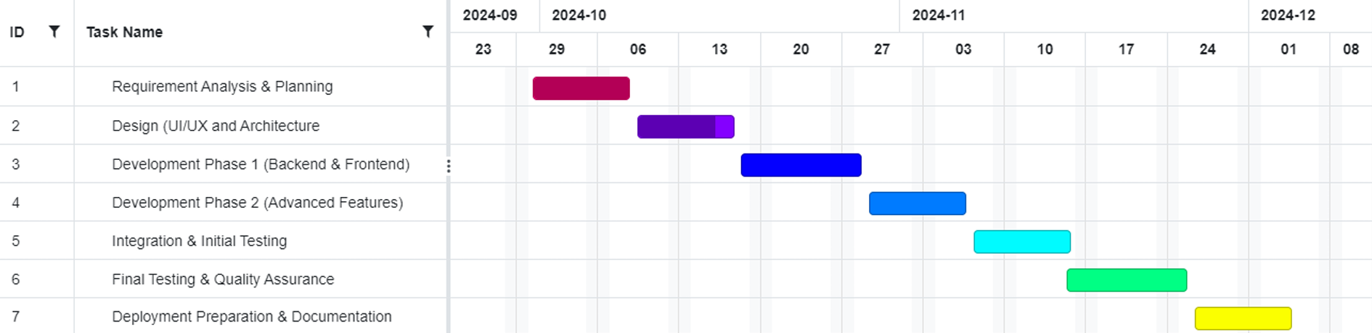
Timeline of Project

Slide 10
Expected Outcomes
Enhanced Tourist Experience
Increased Tourism Revenue
Sustainable Tourism Growth
Seamless Communication and Safety
Environmental Benefits

Slide 11
Conclusion
The development of a One-Stop Solution for Tourism through web and mobile applications offers an unparalleled opportunity to streamline and enhance the travel experience. By building a unified platform that integrates all travel related services from flight bookings and accommodation to local tours and transportation users gain the ability to manage their entire trip with ease, all from a single application accessible on multiple devices.

Slide 12
References
Kumar, A., & Kaur, K. (2020). "Mobile Applications in Indian Tourism: Opportunities and Challenges." Journal of Tourism and Hospitality Management, 8(1), 45-56.
Prasad, R. (2018). "Impact of Mobile Technology on Tourism in India." International Journal of Hospitality & Tourism Systems, 11(1), 15-22.
Bhardwaj, P., & Singh, S. (2019). "Emerging Trends in Digital Marketing for Tourism in India." International Journal of Tourism and Hospitality Reviews, 6(2), 78-85.
Sethi, V., & Kapoor, S. (2021). "Role of Mobile Apps in Promoting Indian Tourism: A Study." Journal of Tourism Research & Hospitality, 10(1), 102-110.
Sharma, J. P., & Sood, A. (2020). "Tourism and Mobile Technology: The Indian Scenario." Global Journal of Research in Tourism and Hospitality Management, 3(2), 100-107.
Choudhary, S. (2017)."The Role of Technology in Enhancing the Tourism Experience in India." Tourism Management Perspectives, 21, 45-52.
Rathi, N., & Singh, R. (2019)"User Acceptance of Mobile Apps in Indian Tourism." International Journal of Tourism Research, 21(5), 612-620.
Sahu, P. K., & Mohanty, S. (2022) "Digital Transformation in Indian Tourism: A Focus on Mobile Applications." Journal of Travel & Tourism Marketing, 39(3), 345-360.
Ghosh, A. (2021) "Understanding the Role of Mobile Technology in Indian Heritage Tourism." Heritage & Society, 14(1), 24-39.
Nayak, J. K., & Jha, R. (2023) "Evaluating Mobile Applications for Travel Planning in India." Tourism Review, 78(4), 803-819.

Slide 13
Thank You

